Slide 1

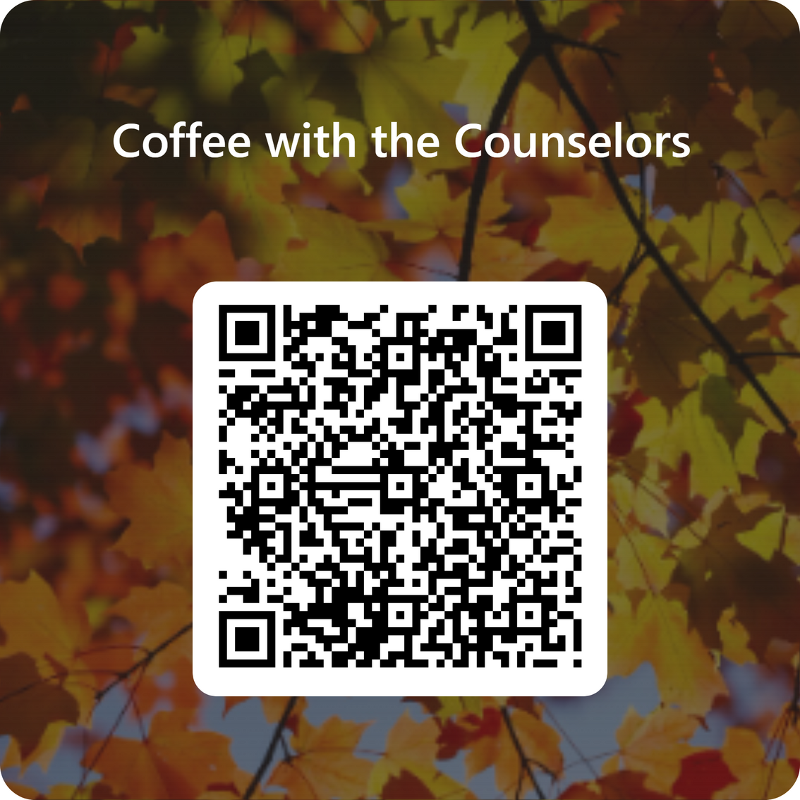

Sign In

Slide 2


Coffee With
the
Counselors
Thursday, October 9, 2025

Slide 3
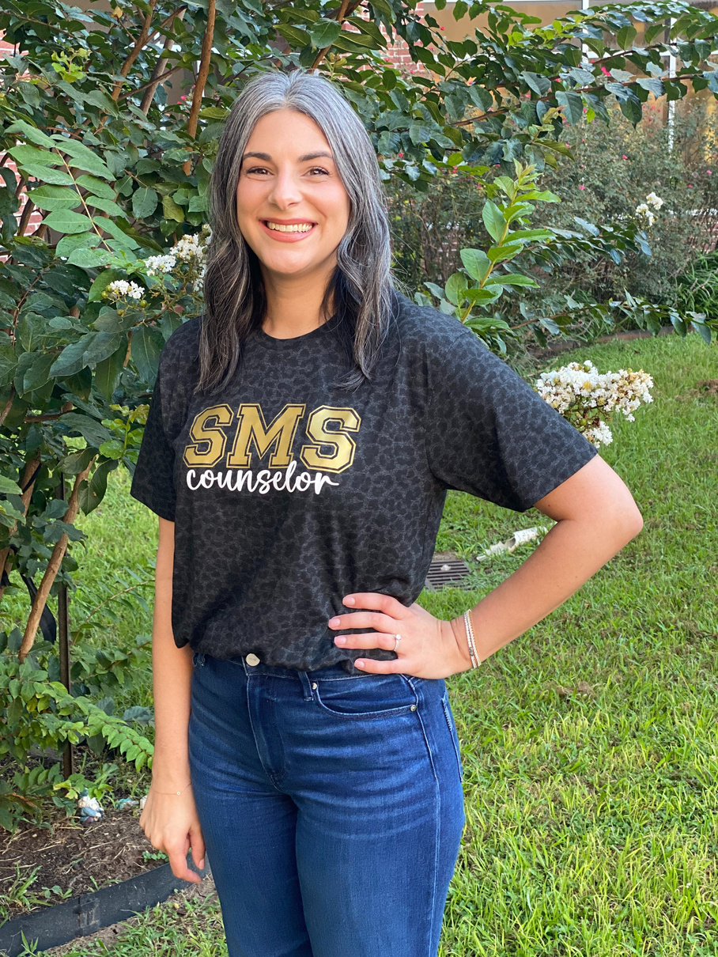
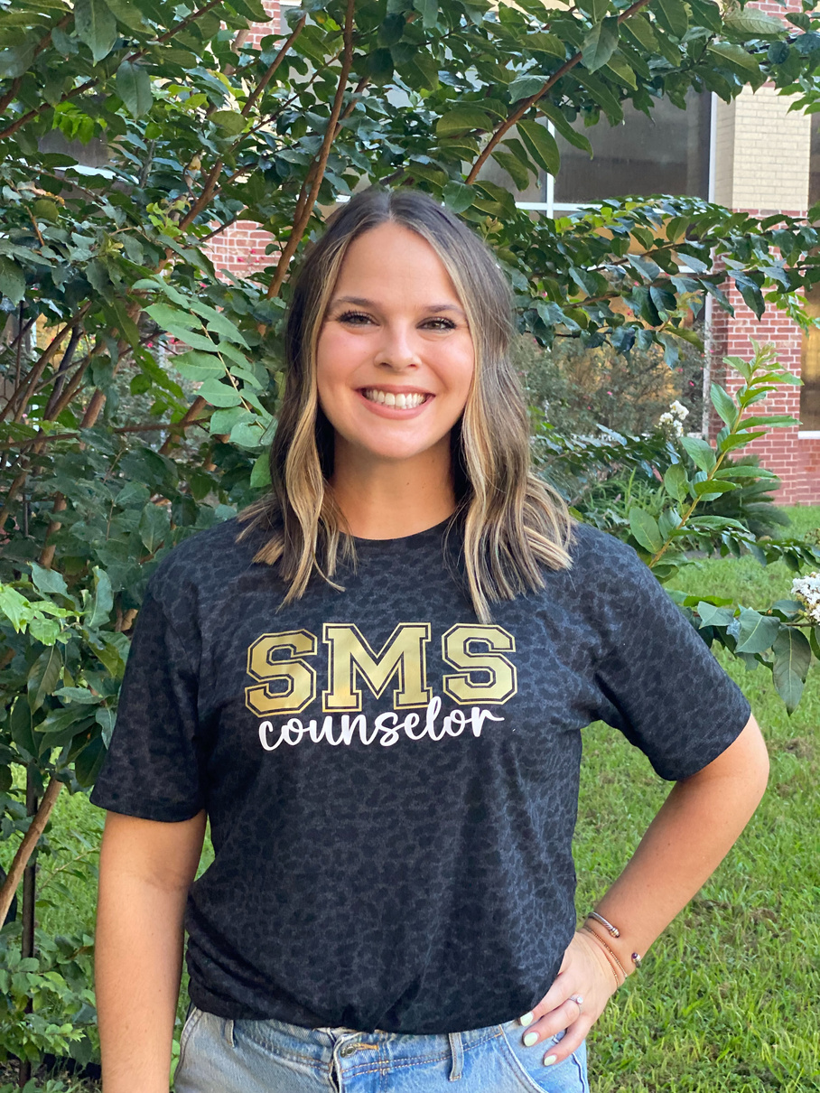
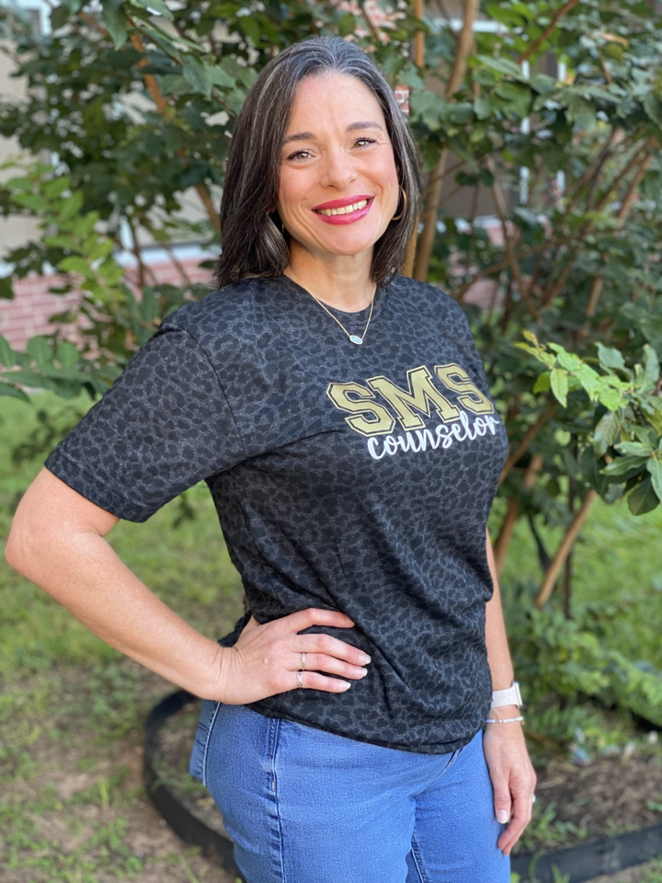

Meet the Counselors
Mrs. Amy Melby
6th Grade Counselor
Mrs. Emily Wilcox
7th Grade Lead Counselor
Mrs. Nicole Byrd
8th Grade Counselor

Slide 4
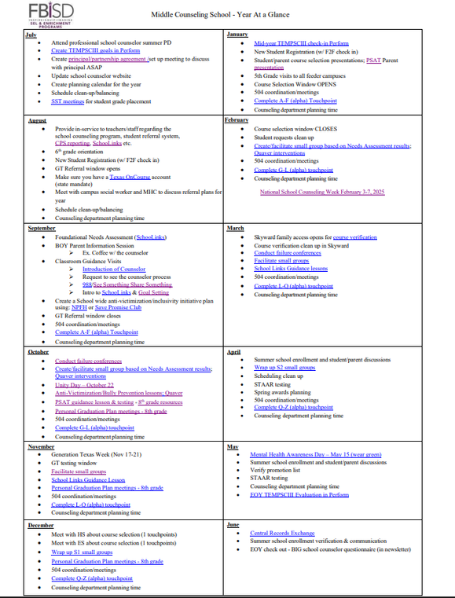

Year at a Glance
Important Dates
  September: Classroom Guidance Lessons (Needs Assessment, See Something,Share Something, SchooLinks Activities), Start with Hello Week
  October: Facilitate Small Groups, Unity Day, Bully Prevention Lessons, Red Ribbon Week, Academy Visits, PSAT Lessons & PSAT Testing (8th Grade)
  November: Classroom Guidance Lessons in SchooLinks, GT Testing, Facilitate Small Groups
  December: Course Selection Planning, 8th Grade Career Day,
  January: PSAT Parent Night, Student Course Selection Opens, 5th Grade Visits, Course Selection Window Opens
  February: Course Selection Closes
  March: Course Verification, Guidance Lessons in SchooLinks
  April: Summer School Enrollment, STAAR Testing, Spring Awards
  May: Mental Health Awareness Day, Summer School Enrollment, STAAR Testing

Slide 5

SchooLinks
6th Grade
Onboarding
Learning Styles
Would you Rather
7th Grade
Intro To SchooLinks
Find Your Path
How to Explore Careers
8th Grade
Intro To SchooLinks
Top Skills
Making the Most out of High School
All students created SMART Goals. These goals are easy for students to understand, track, and achieve. SMART Goals are specific, measurable, achievable, relevant and timely.
Parents need to login to SchooLinks. As a district, we are required to have at least 95% of parents Login to SchooLinks.
Guidance Lessons
Goal Setting
Parent Activities

Slide 6
Needs Assessment
As educators, we understand student mental health plays a key role in their ability to succeed in school. Fort Bend ISD is committed to ensuring your child reaches their full potential socially and emotionally. Each year, students are given the opportunity to share their thoughts and feelings using a Needs Assessment.
The Needs Assessment allows us to respond to our students social/emotional needs and promote wellness throughout the campus.
The Needs Assessment asked questions about the following topics:
Social/Emotional supports
Sense of belonging
Safety
Post-secondary readiness
Based on student answers, we identify students for
small groups counseling.

Slide 7


Monthly Counselor Newsletter
Our Monthly Counselor Newsletter is released on the last Friday or each month.
They are also posted on our SMS Counselor Website.

Slide 8
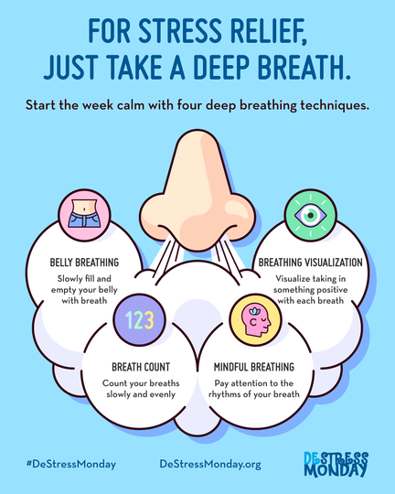
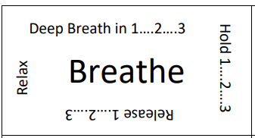


Mindfulness
Mindfulness is a practice that involves being aware of your present moment. It is the basic human ability to be present, aware of where we are and what we are doing, and not overly reactive or overwhelmed by what is going on around us.
Counselors provide a mindfulness
tip every month in
The Roar Report.
Monthly Mindfulness Tip
August - Deep Breathing
Here’s How to Do It:
Breathe in for 3
Hold it for 3
Breath out for 3
September - 10 Second Count
Close your eyes and focus your attention on counting to ten. If your attention wanders while counting, start back at one. The goal for this exercise is to count to ten without losing your focus.

Slide 9
Endorsements
  Animal Science
  Architectural Design
  HVAC & Sheet Metal
  Digital Communications
  Accounting & Financial Services
  Culinary Arts
  Networking Systems
  Welding
  Automotive
  Yearbook
  Newspaper
  Broadcast
  English/Debate
  Teacher & Training
  Diagnostic & Therapeutic Services
  Diagnostic & Therapeutic Services (Reese)
  Cosmetology
  Family & Community Services
  JROTC
  Law Enforcement
  Drawing
  Painting
  Ceramics
  Sculpture
  Digital Art & Media
  Band
  Orchestra
  Color Guard
  Choir
  Piano Tech
  Mariachi
  Theater
  Theater Tech
  Theater Production
  Dance
  World Language
  Social Studies
Students may select a variety of electives to satisfy this endorsement. Students may complete the 4x4 (must include Eng IV and Chem or Physics), or complete 4 credits in AP or dual credit courses
Engineering
Programming & Software Development
Math
Science
Business & Industry
Public Service
Arts & Humanities
Multidisciplinary
STEM

Slide 10

How Can We Help?

